Slide 1

3. IR Spectrum for organic compounds
1) Alkanes
Region | Frequency | Groups and Vibration
Single bonds to hydrogen | 4000～2500cm⁻¹ | O－H、C－H、N－H Stretching Vibration
Triple and cumulated double bonds | 2500~2000cm⁻¹ | C≡C、C≡N、N≡N、C＝C＝C、C＝C＝O Stretching Vibration
Double bonds | 2000~1500cm⁻¹ | C=O、C=C、C=N、NO₂、phenyl Stretching Vibration
Single bonds (fingerprint) | 1500~400cm⁻¹ | C－C、C－O、C－N、C－X Stretching Vibration O－H、C－H、N－H Bending Vibration

Slide 2
Alkanes
Group
Vibration
Peak
Intensity
More
υ_{asCH3}
υ _{sCH3}
δ_{as CH3}
δ_{s CH3}
2962±10
2872±10
1450±10
1380~1370
S
S
m
S
Isopropyl and tert-butyl: splitted double bond around 1380cm⁻¹
υ_{asCH2}
υ _{sCH2}
δ _{CH2}
2926±5
2853±10
1465±20
S
S
m
υ _{sCH}
δ _{CH}
2890±10
~1340
w
w
δ _{CH}
~720
-(CH₂)_{n}-
w
n>=4

Slide 3
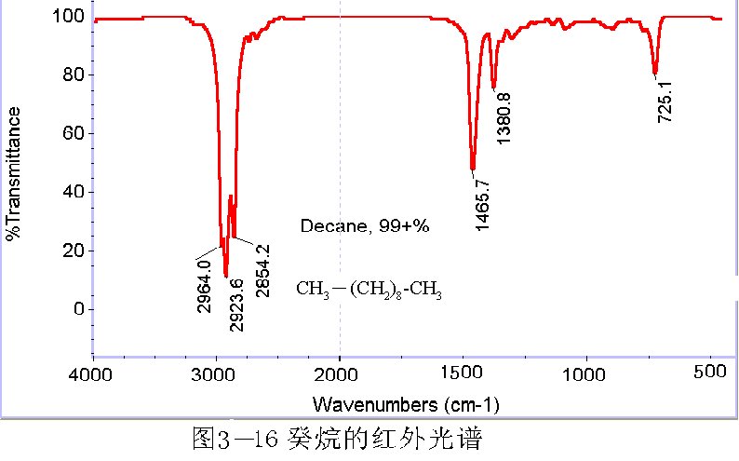
N-decane

Slide 4
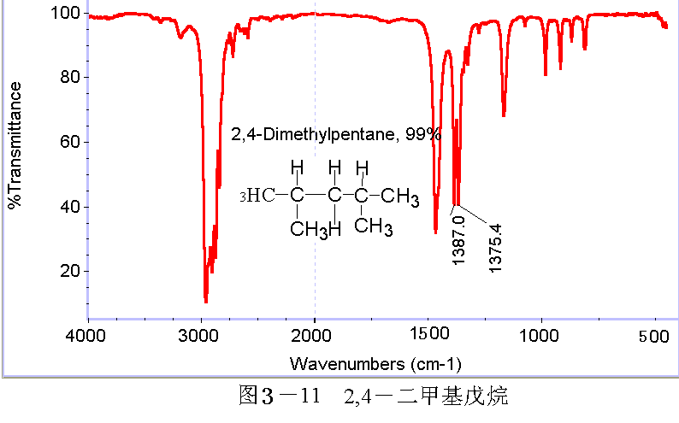
2,4-dimethylpentane
The symmetrical bending vibration frequency of CH₃ is 1380cm⁻¹. When two methyl groups are linked to the same C，vibration coupling is occurred and 1380cm⁻¹ disappeared. Meanwhile, two new peaks, 1385 cm⁻¹ (higher) and 1375 cm⁻¹ (lower) appear. --- Vibration Coupling

Slide 5
2) Alkenes
Region | Frequency | Groups and Vibration
Single bonds to hydrogen | 4000～2500cm⁻¹ | O－H、C－H、N－H Stretching Vibration
Triple and cumulated double bonds | 2500~2000cm⁻¹ | C≡C、C≡N、N≡N、C＝C＝C、C＝C＝O Stretching Vibration
Double bonds | 2000~1500cm⁻¹ | C=O、C=C、C=N、NO₂、phenyl Stretching Vibration
Single bonds (fingerprint) | 1500~400cm⁻¹ | C－C、C－O、C－N、C－X Stretching Vibration O－H、C－H、N－H Bending Vibration

Slide 6
Alkenes
Groups
υ_{=C-H/cm}⁻¹
（int.）
υ_{=C-C/cm}⁻¹
（int.）
_{=C-H/cm-1}
（int.）
R-CH=CH₂
3080(m), 2975(m)
1645（m）
990（s）
910（s）
R₂C=CH₂
3080(m), 2975(m)
1655（m）
890（s）
RCH=CHR,
（cis）
3020（m）
1660（m）
760~730（m）
RCH=CHR,
（trans）
3020（m）
1675（w）
1000~950（m）
R₂C=CHR’
3020（m）
1670
840~790（m）
R₂C=CR₂’
N/A
1670
N/A

Slide 7
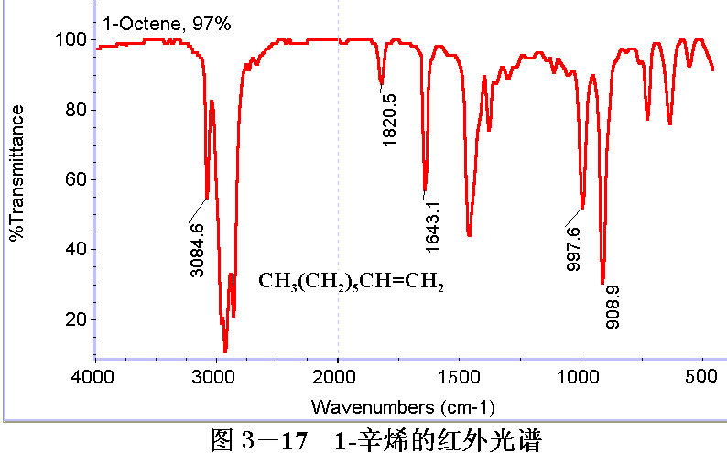
1-Octene
CH₃(CH₂)₅CH=CH₂

Slide 8
3) Alkynes
Region | Frequency | Groups and Vibration
Single bonds to hydrogen | 4000～2500cm⁻¹ | O－H、C－H、N－H Stretching Vibration
Triple and cumulated double bonds | 2500~2000cm⁻¹ | C≡C、C≡N、N≡N、C＝C＝C、C＝C＝O Stretching Vibration
Double bonds | 2000~1500cm⁻¹ | C=O、C=C、C=N、NO₂、phenyl Stretching Vibration
Single bonds (fingerprint) | 1500~400cm⁻¹ | C－C、C－O、C－N、C－X Stretching Vibration O－H、C－H、N－H Bending Vibration

Slide 9
Alkynes
Group | υ_{≡C-H} (int.) | υ_{≡C-C} (int.)
1-Alkynes | 3300 (ms) | 2140-2100 (m)
Unsymmetric n-Alkynes | N/A | 2200 (mw)
Symmetric n-Alkynes | N/A | N/A

Slide 10
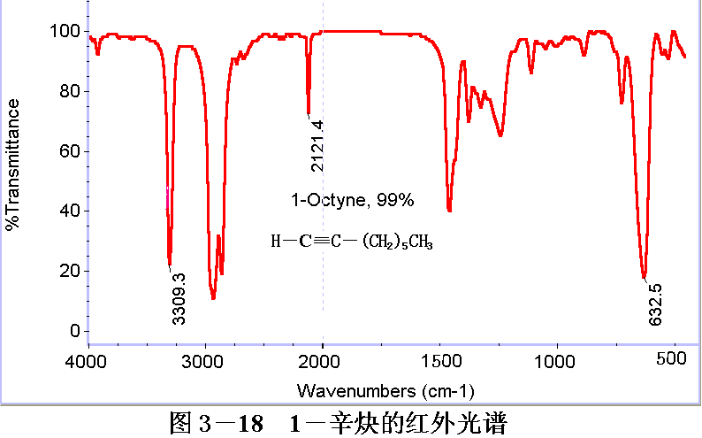
1-Octyne
H－C≡C(CH₂)₅CH₃

